Slide 1
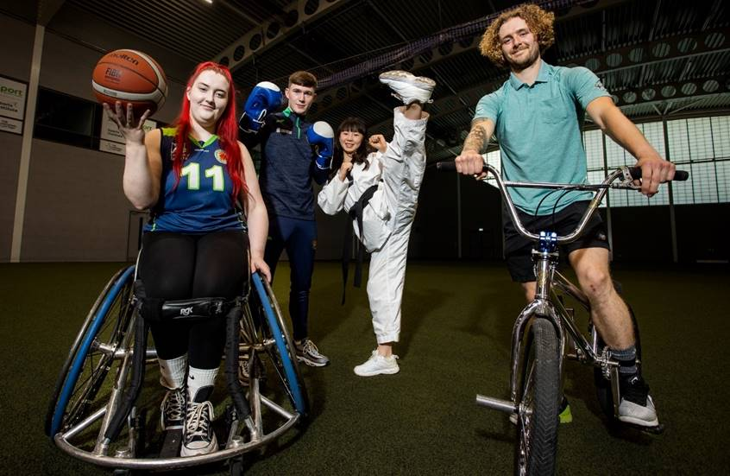
EDI Engagement & Delivery Plans
Women In Sport
Disability In Sport
Racial Inclusion in Sport

Slide 2
EDI Engagement & Delivery Plans
Leadership
Visibility & Advocacy
Participation
Sporting Foundations

Slide 3
2021/22 - The Continuous Household Survey
Women & Girls -
The ‘Problem’
CSSPA (Children’s Sport Participation and Physical Activity) Report 2022
Females (40%) were less likely to have taken part in sport at least once within the last year than males (55%).
17% primary school girls meet the Physical Activity Guidelines compared to 28% primary school boys.
The under-representation of women and girls has long been recognised as one of the most significant problems within sport.
69% post-primary girls participate in sport in a sports club or community setting at least once per week compared to 80% post primary school boys.
Males (42%) were more likely to do 30 minutes of physical activity on five or more days per week than females (33%).
Female 16-year-olds remain the group with by far the lowest level of physical activity (KLT YLT 2023).
Females (27%) were more likely to have no days of doing 30 minutes of physical activity than males (22%).
65% post primary girls participate in sport at school, outside of PE at least once per week compared to 79% post primary school boys

Slide 4
Barriers
Motivators
Lack of female role models/ coaches/ leaders
Poor PE experience at school
Engaging in non-competitive activity that is not considered mainstream sports
Flexibility to dip in and out – no high level of commitment required
Lack of facilities oriented towards women and girls’ use
Lack of time, financial resource and self confidence
Social aspect of playing sport with others of same ability and facing similar issues
Female-specific programmes with female coaches

Slide 5
People With A Disability -
The ‘Problem’
2021 Northern Ireland Census:
24% of the population have a disability or long-term health condition (40% of which were aged 65 or more - 185,300 people).
Opportunities for disabled people to participate in sport and active recreation in Northern Ireland and live full & healthy lives remain significantly lower than the same opportunities provided to non-disabled people
2022/23 The Continuous Household Survey
Adults with a disability were less likely to participate in sport in the previous year (26%) compared to adults without a disability (56%).
Participation rates over the previous four weeks - just over one in five of those with a disability had taken part in sport compared to almost half of all adults without a disability (48%).
21% of disabled people participating in sport at least once in the previous four weeks in 2022/23, representing a 7% drop in participation from 2019/20 (28%)
Sport NI ‘Sport Systems Investment – Governing Bodies’ programme (2023-2024) findings:
The representation of disability within club membership, coaching workforce, officials, and volunteers is significantly lower than those without a disability.
Club members recorded within this investment period - 433,131 across 36 sports, only 1,916 were recorded as disabled club members. (0.4%)

Slide 6
Barriers
Motivators
Meet like-minded people enabling a sense of belonging and creation of friendships
Opportunities for greater inclusion
e.g. mixed ability sessions
Non accessible facilities & a lack of awareness of accessibility issues
Lack of accredited coaches to deliver for those with disabilities
Lack of diversity at senior level within sporting organisations
Lack of promotion of disability sport​ and disability in sport focused investment
Opportunities to develop specific athletic skills and access competition pathways
Greater visibility & awareness of disability only tailored sporting programmes

Slide 7
Racial Inclusion - The ‘Opportunity ‘
The representation of ethnic groups has been recognised in recent years as a challenge within sport across Northern Ireland.
It is evident that there is a changing population across Northern Ireland:
2001 2011 2021
Population % Population % Population %
White 1,671,013 99.15 1,778,449 98.21 1,837,575 96.55
In total, 65,604 (3.45%) belonged to ethnically diverse communities.
The ethnically diverse communities with the highest prevalence were those belonging to the Mixed Ethnicity (14,382) categorisation, followed by those belonging to the Indian (9,881), Chinese (9,495), and Black African (8,069) ethnicity categorisations.

Slide 8
Barriers
Motivators
Lack of fit for purpose facilities
Lack of transport to and from training, events etc.
Clubs being welcoming to new members regardless of their background
Society integration - meeting others from similar communities
Lack of opportunities to be introduced to new sports/physical activities
Lack of programmes in areas aimed at ethnically diverse communities
Creating a sense of belonging and reducing social isolation
11% of respondents have the Chairperson of their organisation from an ethnically diverse community (Sport NI EDI
survey 2024)

Slide 9
What is Sport NI doing?
Developing Baseline Data
Engaging with Stakeholders
Identifying and working to eradicate barriers
How can Sport NI help working in partnership with
the sector eradicate inequalities in sport?
Dedicated Women in Sport Campaign
Develop investment opportunities
Develop programmes to enhance participation in sport at leadership and workforce levels
Providing resources and toolkits enabling organisations to review their provision/culture to enhance the experience in sport of underrepresented groups

